Slide 1
通用輸入輸出埠 GPIO

Slide 2
Outline
SampleCode Projects to cover:
GPIO_LED
GPIO_Keypad
GPIO_Buzzer
GPIO_7seg
GPIO_7seg_keypad
2

Slide 3
General Purpose I/O (GPIO)
Overview
The NuMicro NUC140 has up to 80 General Purpose I/O pins that can be shared with other function pins depending on the chip configuration.
These 80 pins are arranged in 5 ports named with GPIOA, GPIOB, GPIOC, GPIOD and GPIOE. Each port has maximum 16 pins.
Each one of the 80 pins is independent and has the corresponding register bits to control the pin mode function and data.
Features
Four I/O modes:
Input only with high impendence
Push-Pull output
Open-Drain output
Quasi bi-direction
3

Slide 4
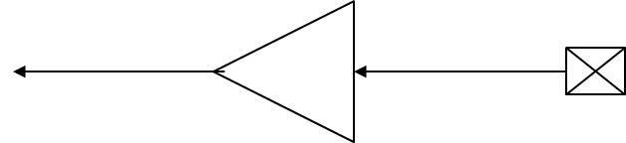
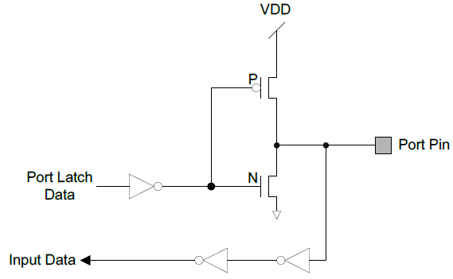
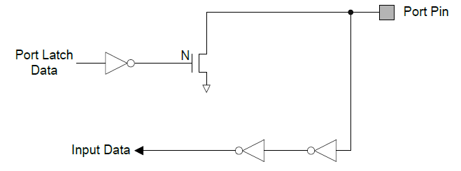
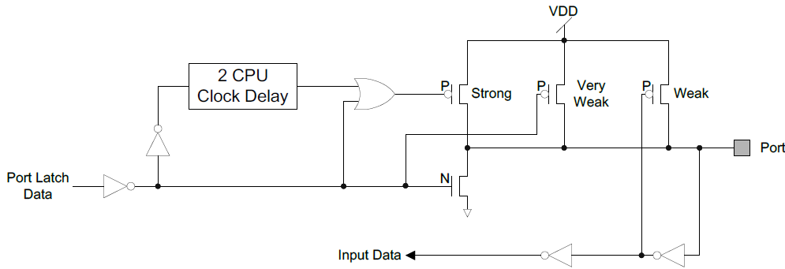
General Purpose I/O (GPIO)
Input only with high impedance
Set GPIOx_PMD (PMDn[1:0]) to 00b,
the GPIOx port [n] pin is in Input mode
Push-Pull Output
Set GPIOx_PMD (PMDn[1:0]) to 01b,
the GPIOx port [n] pin is in Output mode
Open-Drain output
Set GPIOx_PMD (PMDn[1:0]) to 10b,
the GPIOx port [n] pin is in Open-Drain mode
Quasi bi-direction
Set GPIOx_PMD (PMDn[1:0]) to 11b,
the GPIOx port [n] pin is in Quasi-bidirectional mode
4

Slide 5
Library/StdDriver: gpio.c
Functions
GPIO_SetMode (GPIO_T *port, uint32_t u32PinMask, uint32_t u32Mode)
GPIO_EnableInt (GPIO_T *port, uint32_t u32Pin, uint32_t u32IntAttribs)
GPIO_DisableInt (GPIO_T *port, uint32_t u32Pin)
GPIO_SetMode (GPIO_T *port, uint32_t u32PinMask, uint32_t u32Mode)
This function is used to set specified GPIO operation mode.
Parameters
[in] port GPIO port. It could be PA, PB, PC, PD, or PE.
[in] u32PinMask The single or multiple pins of specified GPIO port.
It is BIT0 ~ BIT15 for PA, PB, PC, PD and PE GPIO port.
[in] u32Mode Operation mode. . It could be GPIO_PMD_INPUT, GPIO_PMD_OUTPUT, GPIO_PMD_OPEN_DRAIN, GPIO_PMD_QUASI.
return None
Example
Output value : PC12 = 0; Read Input : if (PC12 !=0) { }
5

Slide 6
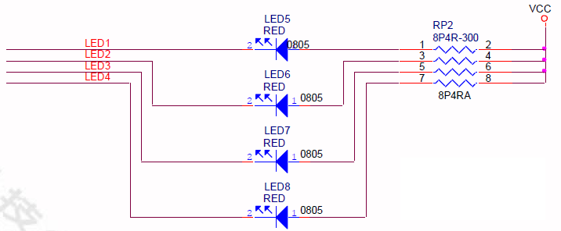
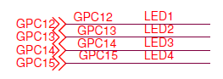
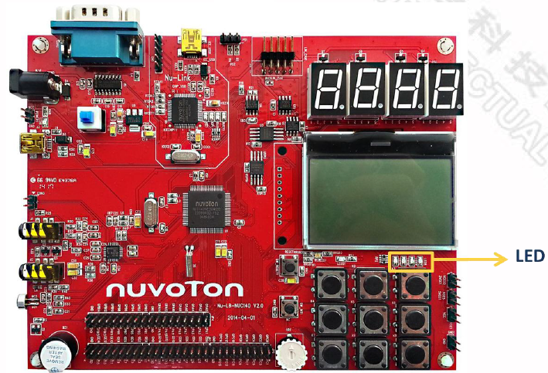
GPIO pins to drive LEDs
GPC12-GPC15 to control LEDs
6

Slide 7
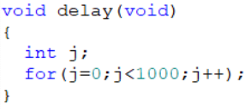
SampleCode: GPIO_LED
int main(void)
{
SYS_Init();
GPIO_SetMode(PC, BIT12, GPIO_MODE_OUTPUT);
while(1) {
PC12 =0; // turn on LED
CLK_SysTickDelay(100000); // Delay
PC12 =1; // turn off LED
CLK_SysTickDelay(100000); // Delay
}
}
Initialize Clocks & Pins
Generate 100000us=0.1s delay
Another way to generate delay: easier but not predictable
7

Slide 8
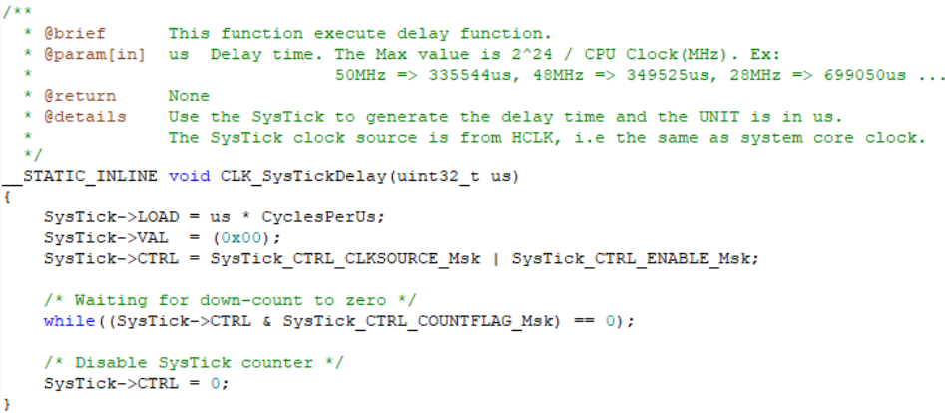
CLK.h
8

Slide 9
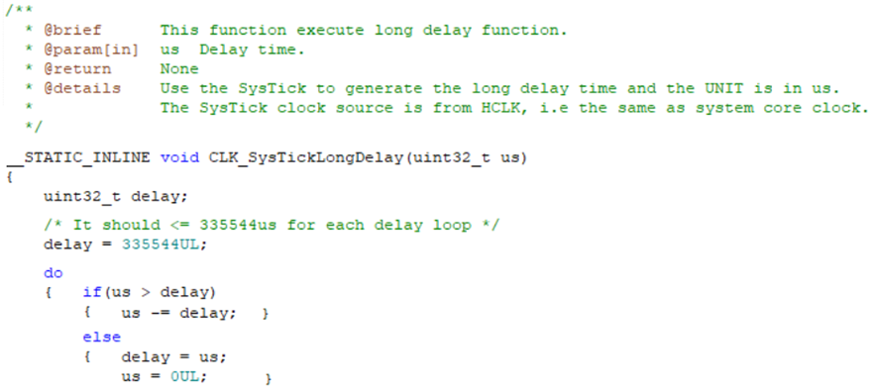
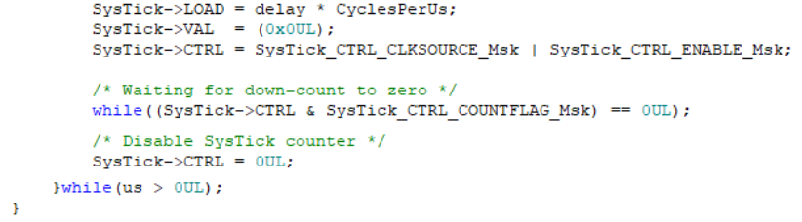
CLK.h
9

Slide 10
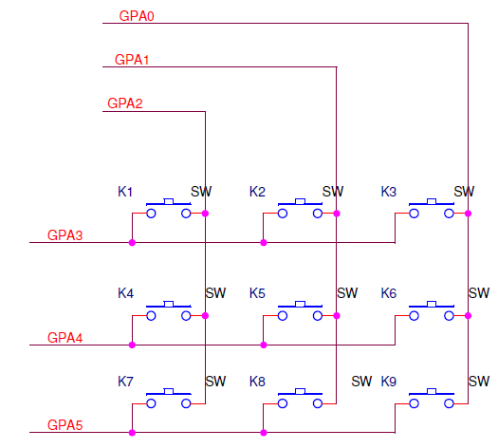
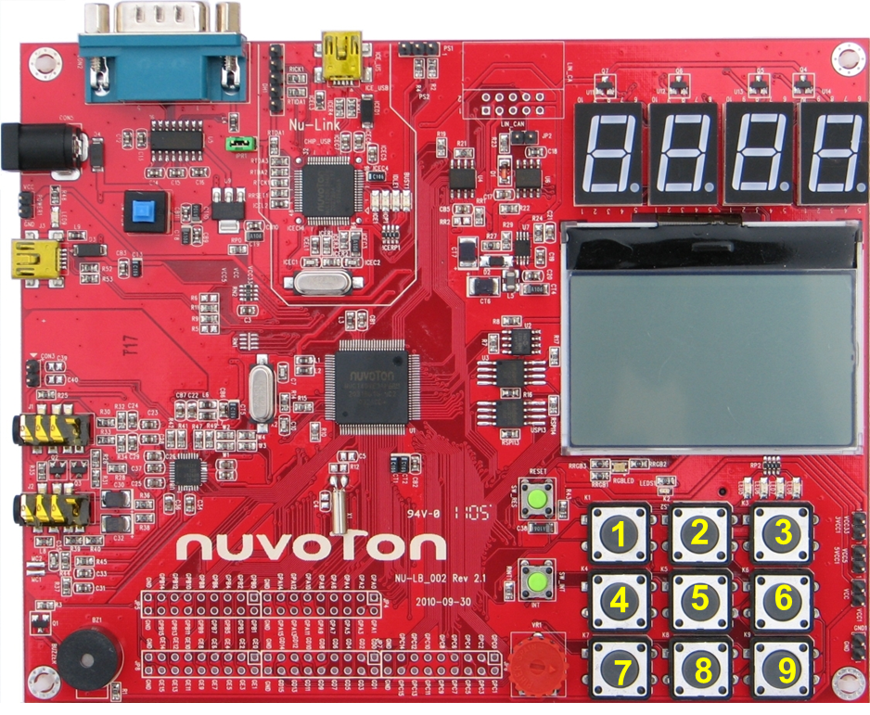
3x3 Keypad on Learning board
10

Slide 11
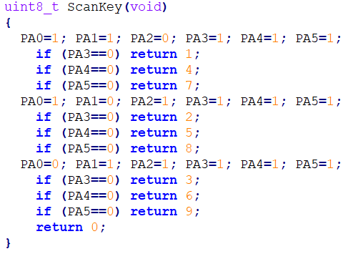
Library/Nu-LB-NUC140: Scankey.c
Functions
OpenKeyPad (void)
ScanKey (void)
OpenKeyPad (void)
Key press will connect output pin to input pin
11

Slide 12
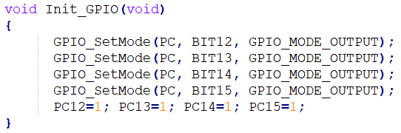
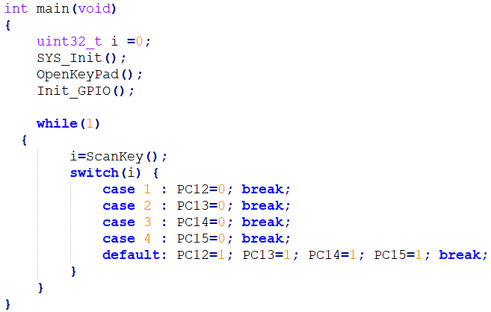
SampleCode: GPIO_Keypad
12

Slide 13
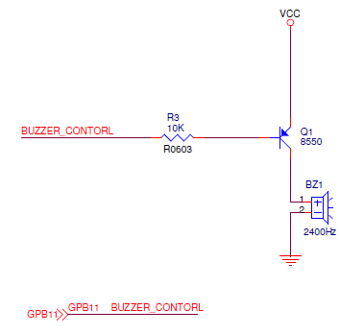
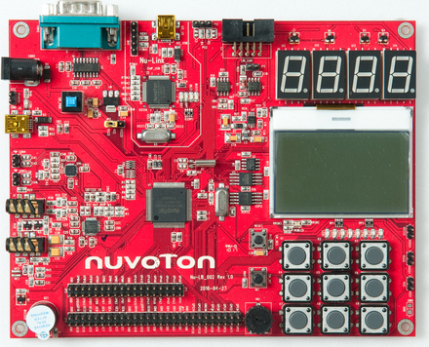
Buzzer on Learning board
13

Slide 14
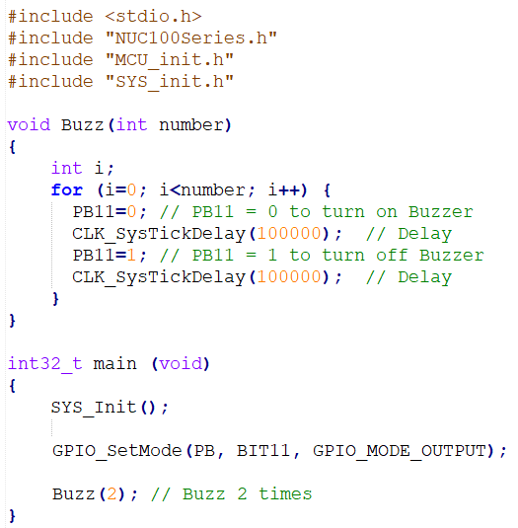
SampleCode: GPIO_Buzzer
14

Slide 15
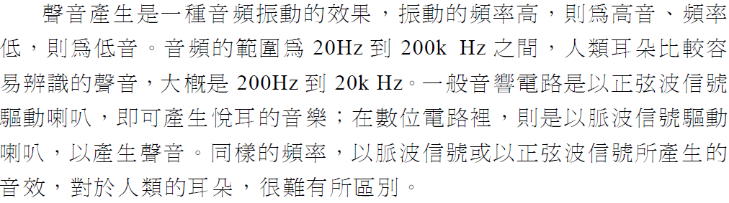
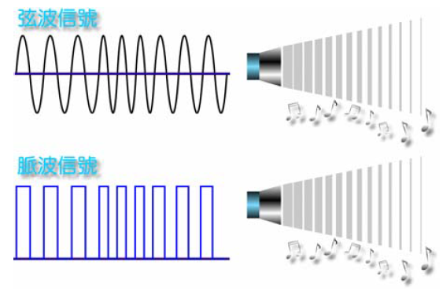
聲音的產生
Notes:
credential:
bring a computer
die photo
wafer
:
This can be an hidden slide. I just want to use this to do my own planning.
I have rearranged Culler’s lecture slides slightly and add more slides. This covers everything he covers in his first lecture (and more) but may
We will save the fun part, “ Levels of Organization,” at the end (so student can stay awake): I will show the internal stricture of the SS10/20.
Notes to Patterson: You may want to edit the slides in your section or add extra slides to taylor your needs.

Slide 16
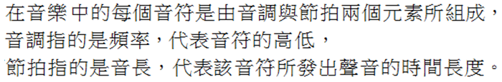
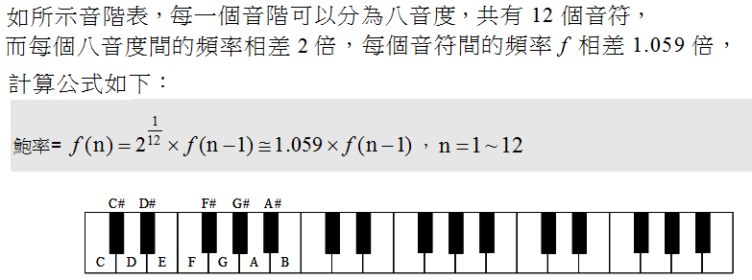
音調與節拍
Notes:
credential:
bring a computer
die photo
wafer
:
This can be an hidden slide. I just want to use this to do my own planning.
I have rearranged Culler’s lecture slides slightly and add more slides. This covers everything he covers in his first lecture (and more) but may
We will save the fun part, “ Levels of Organization,” at the end (so student can stay awake): I will show the internal stricture of the SS10/20.
Notes to Patterson: You may want to edit the slides in your section or add extra slides to taylor your needs.

Slide 17
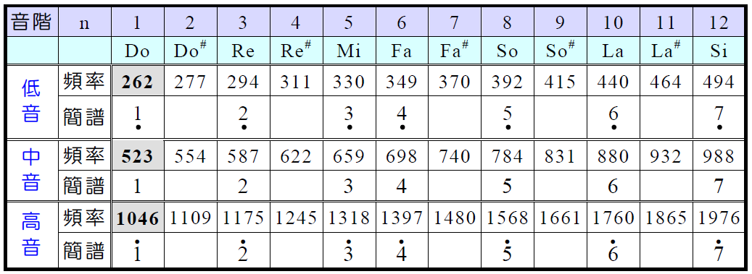
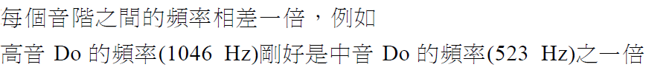
音調 (Tone)
表 1、
Notes:
credential:
bring a computer
die photo
wafer
:
This can be an hidden slide. I just want to use this to do my own planning.
I have rearranged Culler’s lecture slides slightly and add more slides. This covers everything he covers in his first lecture (and more) but may
We will save the fun part, “ Levels of Organization,” at the end (so student can stay awake): I will show the internal stricture of the SS10/20.
Notes to Patterson: You may want to edit the slides in your section or add extra slides to taylor your needs.

Slide 18
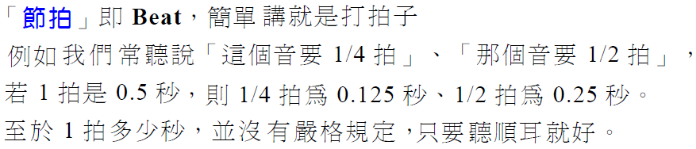
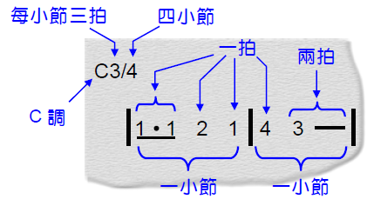
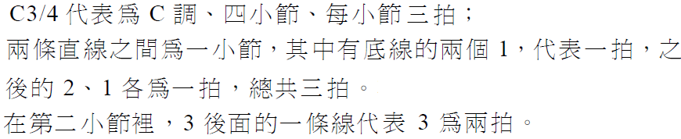
節拍(Beat)與音節
Notes:
credential:
bring a computer
die photo
wafer
:
This can be an hidden slide. I just want to use this to do my own planning.
I have rearranged Culler’s lecture slides slightly and add more slides. This covers everything he covers in his first lecture (and more) but may
We will save the fun part, “ Levels of Organization,” at the end (so student can stay awake): I will show the internal stricture of the SS10/20.
Notes to Patterson: You may want to edit the slides in your section or add extra slides to taylor your needs.

Slide 19

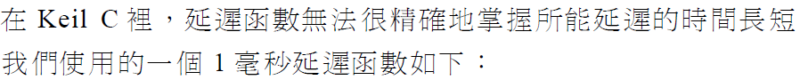
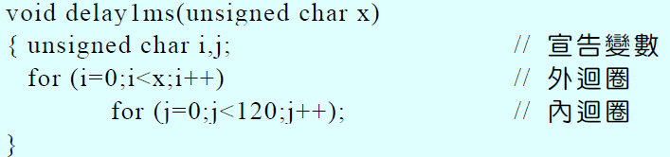
音調的產生
若要產生表1 的音調，可使用延遲函數(delay function)或Timer 計時中斷
Notes:
credential:
bring a computer
die photo
wafer
:
This can be an hidden slide. I just want to use this to do my own planning.
I have rearranged Culler’s lecture slides slightly and add more slides. This covers everything he covers in his first lecture (and more) but may
We will save the fun part, “ Levels of Organization,” at the end (so student can stay awake): I will show the internal stricture of the SS10/20.
Notes to Patterson: You may want to edit the slides in your section or add extra slides to taylor your needs.

Slide 20
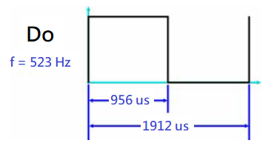
音調的產生 – 使用delay function
In NUC140, 中音 Do 可以 CLK_SysTickDelay(956) 來產生
:
:
中音 Si 可以 CLK_SysTickDelay(506) 來產生
Notes:
credential:
bring a computer
die photo
wafer
:
This can be an hidden slide. I just want to use this to do my own planning.
I have rearranged Culler’s lecture slides slightly and add more slides. This covers everything he covers in his first lecture (and more) but may
We will save the fun part, “ Levels of Organization,” at the end (so student can stay awake): I will show the internal stricture of the SS10/20.
Notes to Patterson: You may want to edit the slides in your section or add extra slides to taylor your needs.

Slide 21
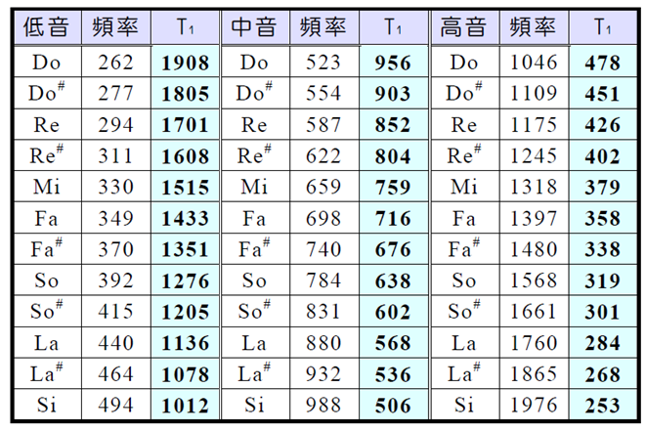
音調的產生 – 使用 CLK_SysTickDelay()
Notes:
credential:
bring a computer
die photo
wafer
:
This can be an hidden slide. I just want to use this to do my own planning.
I have rearranged Culler’s lecture slides slightly and add more slides. This covers everything he covers in his first lecture (and more) but may
We will save the fun part, “ Levels of Organization,” at the end (so student can stay awake): I will show the internal stricture of the SS10/20.
Notes to Patterson: You may want to edit the slides in your section or add extra slides to taylor your needs.

Slide 22
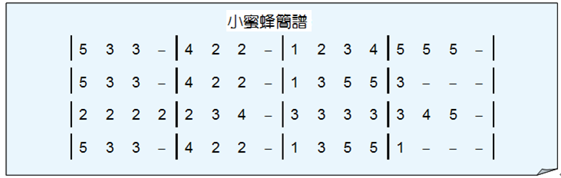
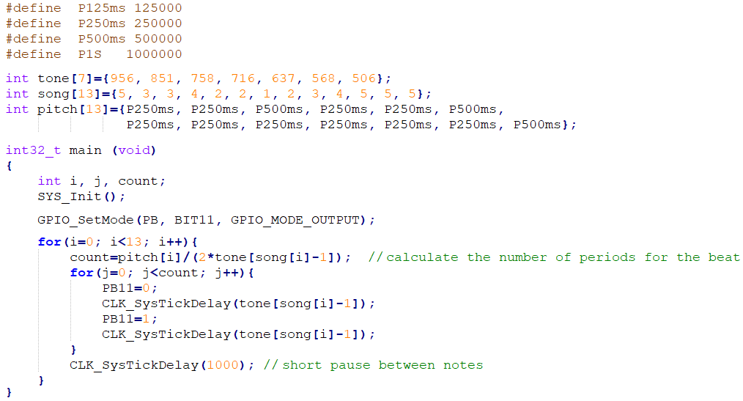
使用 CLK_SysTickDelay() 播放旋律 – 小蜜蜂
Notes:
credential:
bring a computer
die photo
wafer
:
This can be an hidden slide. I just want to use this to do my own planning.
I have rearranged Culler’s lecture slides slightly and add more slides. This covers everything he covers in his first lecture (and more) but may
We will save the fun part, “ Levels of Organization,” at the end (so student can stay awake): I will show the internal stricture of the SS10/20.
Notes to Patterson: You may want to edit the slides in your section or add extra slides to taylor your needs.

Slide 23
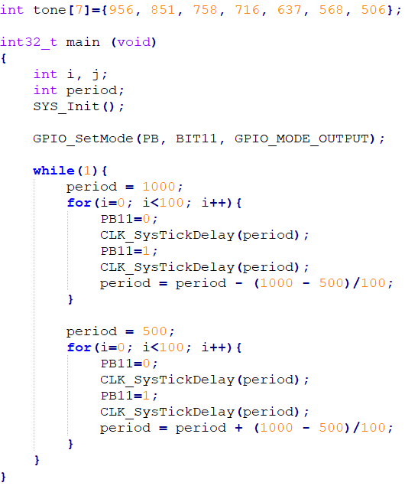
使用 CLK_SysTickDelay() 播放旋律 – 警報器
Notes:
credential:
bring a computer
die photo
wafer
:
This can be an hidden slide. I just want to use this to do my own planning.
I have rearranged Culler’s lecture slides slightly and add more slides. This covers everything he covers in his first lecture (and more) but may
We will save the fun part, “ Levels of Organization,” at the end (so student can stay awake): I will show the internal stricture of the SS10/20.
Notes to Patterson: You may want to edit the slides in your section or add extra slides to taylor your needs.

Slide 24
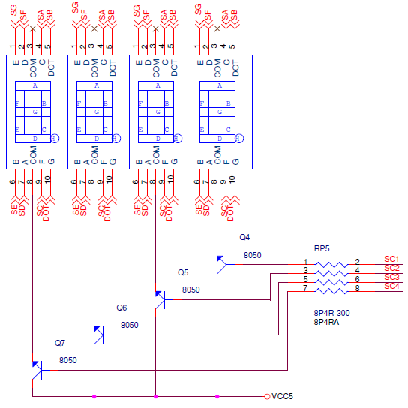
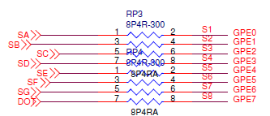
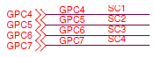
7-segment LEDs on Learning board
24

Slide 25
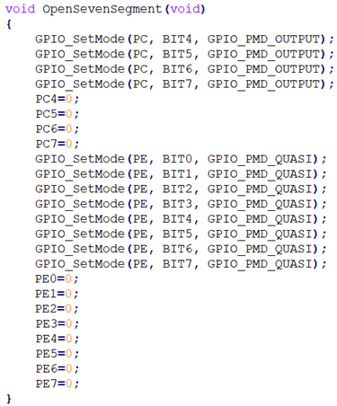
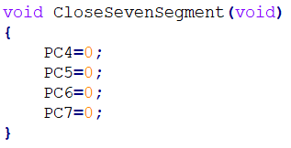
Library/Nu-LB-NUC140: Seven_Segment.c
Functions
OpenSevenSegment(void)
ShowSevenSegment(uint8_t no, uint8_t number)
CloseSevenSegment(void)
OpenSevenSegment (void)
CloseSevenSegment (void)
25

Slide 26
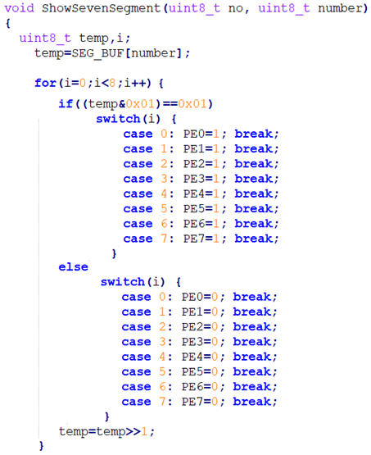
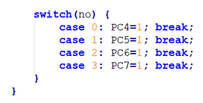
Library/Nu-LB-NUC140: Seven_Segment.c
ShowSevenSegment (uint8_t no, uint8_t number)
26

Slide 27
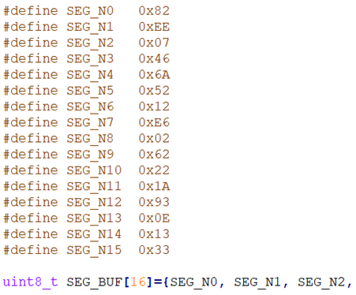
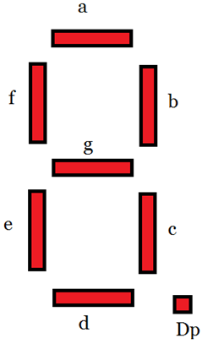
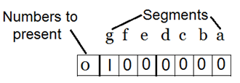
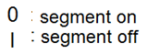
Library/Nu-LB-NUC140: Seven_Segment.c
temp (8 bits): PE7 PE6 PE5 PE4 PE3 PE2 PE1 PE0
DOT G F E D C B A
G E D B A F DOT C
(Note: the arrangement of segment pins is not the same as indicated in the schematic.)
27

Slide 28
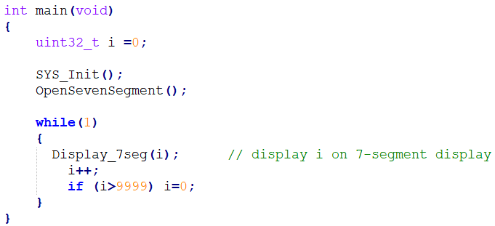
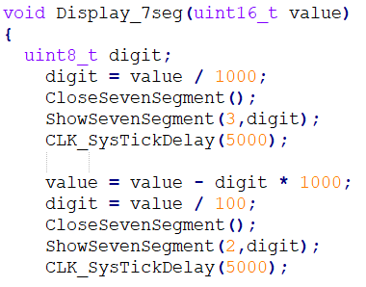
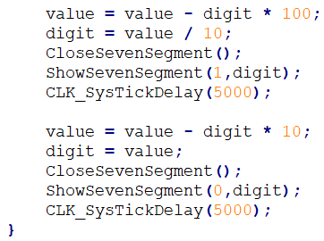
SampleCode: GPIO_7seg
28

Slide 29
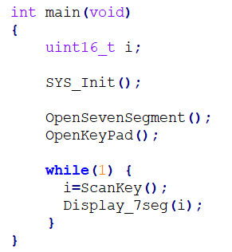

SampleCode: GPIO_7seg_keypad
29

Slide 30


SampleCode: GPIO_7seg_keypad
原始
(手指需持續按著)
修改後
(1. 按後即可放手 )
(2. 不再顯示 ”0” )
30

Slide 31


修改 main.c (1)
31

Slide 32

修改 Seven_Segment.c (2)
32

Slide 33




SampleCode: GPIO_7seg_keypad4
因為專案包含 retarget.c, 所以printf 必須在Debug模式下, 選擇 Serial Windows -> Uart #1
才能看到執行的結果
產生額外延遲
33

Slide 34



SampleCode: GPIO_7seg_keypad4
按一下數字, 會連續出現,
最後只剩最右邊有數字
34

Slide 35

Button Debouncing
軟體作法一: 就是先讀取一次，隔一段時間後，再讀取一次。如果持續 n 次 (i.e., n=4), 的狀態都一樣，就視為按鍵處於穩定狀態，否則就是 bouncing。
軟體作法二: 由於一般彈跳時間約在10ms~20ms間，也可直接延遲20ms後再讀取按鍵值.
35

Slide 36


GPIO_7seg_keypad4 (modified)
在七段顯示器上，從右插入Keypad輸入的數字。
如果輸入超過4個數字, 則最左邊數字消失
36

Slide 37


Persistence of vision
如何利用視覺暫留, 讓一個4位數顯示0.3秒?
v.s.
37

Slide 38


RGB LED on Learning board
38

Slide 39


SampleCode: GPIO_RGBLED
39

